Slide 1
Predicting the Popularity of Online News: a comparison of Naïve Bayes, KNN, and C4.5
A research paper for data mining
By Ignacio Inostroza-Quezada
Abhinav Singh
Ting Sun
Zhenyi Yuan
April 25, 2016

Slide 2
Research Question
Presented by Ignacio Inostroza-Quezada
What characteristics of an online news article make it popular among readers?

Slide 3
Introduction: the Online News
Presented by Ignacio Inostroza-Quezada
Internet in the information domain: online news.
Key benefits of online news for users (Karlsson and Strömbach, 2010):
Interactivity
immediacy
Online news articles:
disrupted the news industry
allow firms to advertise products
Importance of popularity of online news (Tsagkias et al., 2009):
Attractiveness of articles and their publication time
Profitability for online news companies
Readers can reduce seek time

Slide 4
A literature review
Presented by Ignacio Inostroza-Quezada
Knochbloch-Westerwick et al. (2005):
Highly rated articles are read longer
Online readers prefer articles viewed by few or many people.
Ziegele et al. (2014): online news that produce more comments are
challenging, unexpected
directed to a specific person
long in words

Slide 5
Literature Review (cont’d)
Presented by Ignacio Inostroza-Quezada
Liu et al. (2015). Online news that produce more comments:
are more recommended by friends
have multimedia elements (e.g. videos)
have a negative content
allow readers to speculate
are related to real-life
include opinions of experts (finance and SciTech only)
Reis et al. (2015)
Popular headings have polarized assessments
comments about headings are often negative

Slide 6
Literature Review (cont’d)
Presented by Ignacio Inostroza-Quezada
Ren and Yang (n.d.):
examined online articles with UCI Learning Machine Repository data (Fernandez et al., 2015)
used ten models to predict popularity of online news before publication
found that Random Forest performed better than other prediction models

Slide 7
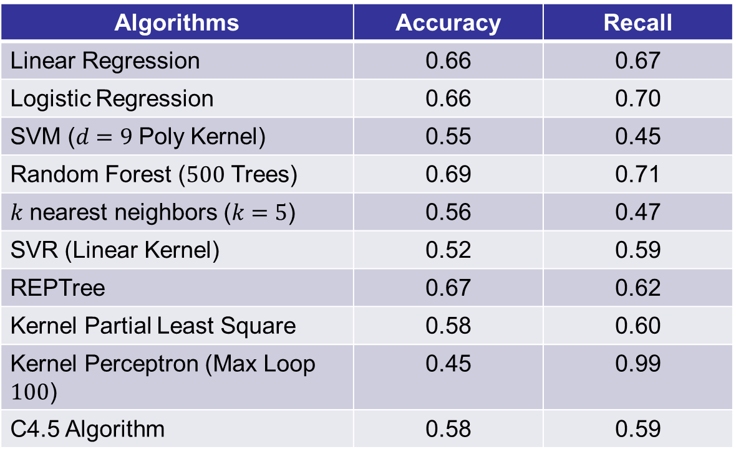
Literature Review (cont’d)
Presented by Ignacio Inostroza-Quezada
Algorithms | Accuracy | Recall
Linear Regression | 0.66 | 0.67
Logistic Regression | 0.66 | 0.70
SVM ($d=9$ Poly Kernel) | 0.55 | 0.45
Random Forest ($500$ Trees) | 0.69 | 0.71
$k$ nearest neighbors ($k=5$) | 0.56 | 0.47
SVR (Linear Kernel) | 0.52 | 0.59
REPTree | 0.67 | 0.62
Kernel Partial Least Square | 0.58 | 0.60
Kernel Perceptron (Max Loop $100$) | 0.45 | 0.99
C4.5 Algorithm | 0.58 | 0.59

Slide 8
Research Method
Presented by Zhenyi Yuan
Naive Bayes
C4.5
KNN

Slide 9
Naïve Bayes
Presented by Zhenyi Yuan
Bayes Theorem
Conditional Probability
Pros:
Naïve Bayes is used to do sentiment analysis and NLP in research papers
Cons:
Strong assumption that variables are independent of each other

Slide 10
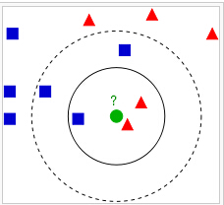
KNN
Presented by Zhenyi Yuan
Majority wins
Lazy learning

Slide 11
KNN (cont’d)
Presented by Zhenyi Yuan
Limitations:
Curse of dimensionality
How to decide K?
Since it’s not difficult to decide the distance in our dataset, we used KNN to compare with other methods

Slide 12
Decision Tree-C4.5
Presented by Zhenyi Yuan
Pros:
intuitive
No biases compared to Ripper
Limitations:
As long as the tree is not too big and the accuracy is relatively high, C4.5 will be a good choice.

Slide 13

Data
Presented by Ting Sun
Raw data:
Our original dataset is provided by UCI machine learning repository
61 attributes (e.g., keywords, digital media content, earlier popularity of news referenced in the article) and 39797 instances published by Mashable
Data preprocessing:
target variable: POPULARITY, which equals 1 if the number of shares of an article is larger than 3395.38 (median), and 0 otherwise.
Data Partition:
Training data - 60% (23786 instances)
10-fold cross validation in the training data
Testing data - 40% (15858 instances)
Tool: WEKA 3.6.13
Notes:
The articles were published by Mashable (www.mashable.com)
This is a large dataset with 61 attributes and 39797 instances
(the median of the shares for the whole data of news articles)
The decision threshold was 1400, to simplify the task and make it balanced we use median

Slide 14
Feature selection
Presented by Ting Sun
Method: CFS (Correlation based Feature Selection) (Hall, 1998).
- highly correlated with the class while having low intercorrelation
Search method: greedy hillclimbing augmented with a backtracking facility.
- start with the empty set of attributes and search forward by considering all possible single attribute additions and deletions at a point where there are 5 consecutive non-improving nodes.
11 independent attributes are kept
Notes:
A full feature set may include much noise. We use feature selection to select our attributes, which gives us 11 attributes as the independent variables.
The feature selection method is CFS (Correlation based Feature Selection) (Hall, 1998). It evaluates the worth of a subset of attributes by considering the individual predictive ability of each feature along with the degree of redundancy between them. Subsets of features that are highly correlated with the class while having low intercorrelation are preferred.
We search the space of attribute subsets by greedy hillclimbing augmented with a backtracking facility. Setting the number of consecutive non-improving nodes allowed controls the level of backtracking done. We start with the empty set of attributes and search forward by considering all possible single attribute additions and deletions at a point where there are 5 consecutive non-improving nodes.

Slide 15
Selected attributes and definitions
Presented by Ting Sun
Table 1 A list of selected attributes and definitions
Variable | Explanation
Dependent variable : popularity | =1 if the number of shares of the online news is larger than its median, which is 3395.38 =0, otherwise
num_imgs | Number of images
data_channel_is_entertainment | = 1 if data channel is 'Entertainment' =0, otherwise
data_channel_is_socmed | = 1 if data channel is 'Social Media' =0, otherwise
data_channel_is_world | = 1 if data channel is 'world' =0 ,otherwise
kw_min_avg | Avg. keyword (min. shares)
kw_max_avg | Avg. keyword (max. shares)
kw_avg_avg | Avg. keyword (avg. shares)
self_reference_min_shares | Min. shares of referenced articles in Mashable website
self_reference_avg_shares | avg. shares of referenced articles in Mashable
is_weekend | =1, if the article published on a weekend =0, otherwise
lda_02 | Closeness to LDA topic 2
Notes:
Min shares of average keyword
LDA Topic 2: Latent Dirichlet Allocation
In LDA, each document may be viewed as a mixture of various topics.
n natural language processing, Latent Dirichlet allocation (LDA) is a generative statistical model that allows sets of observations to be explained by unobserved groups that explain why some parts of the data are similar. For example, if observations are words collected into documents, it posits that each document is a mixture of a small number of topics and that each word's creation is attributable to one of the document's topics. LDA is an example of a topic model

Slide 16
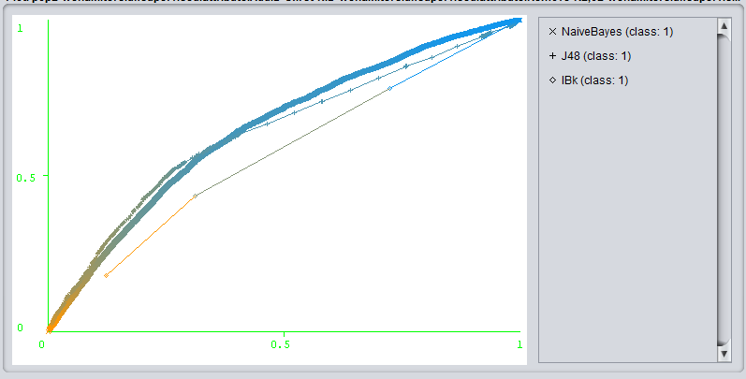
Predictive performance
Presented by Ting Sun
Table 1: Experiment results of three algorithm
Detailed Accuracy by Class: C4.5
Machine Learning Algorithms | Correctly Classified Instances | Kappa Statistic | Root Mean Squared Error | Weighted average F-measure | Time for model establishment
Naive Bayes | 65.09% | 0.17 | 0.50 | 0.62 | 0.08
K Nearest Neighbor – K = 10 | 65.24 % | 0.17 | 0.48 | 0.62 | 0.02
Decision Tree-C4.5 | 66.03% | 0.20 | 0.47 | 0.64 | 1.07
Class | TP Rate | FP Rate | Precision | Recall | F-Measure | ROC Area
0 | 0.81 | 0.58 | 0.71 | 0.81 | 0.76 | 0.64
1 | 0.42 | 0.19 | 0.55 | 0.42 | 0.48 | 0.64
Weighted average | 0.67 | 0.44 | 0.66 | 0.67 | 0.66 | 0.64
ROC Curves
Confusion matrix: C4.5
 | Predicted 0 | Predicted 1
Actual 0 | 8241 | 1923
Actual 1 | 3314 | 2380
Notes:
Experiment results for training data
We reevaluate the model using the test dataset, which has a better result (overall accuracy of 67% and 0.24 kappa).
From the experiment results in table 1, C4.5 performs better than the other two classifiers in four of the five measurements; therefore, this classifier can provide the most accurate classification.
However, it has huge tree size (Number of Leaves: 126 and Size of the tree: 251). This suggests us to prune the tree. We pruned the tree to reduce tree size by setting the minimum objects of leaves as 20. The tree has 27 Leaves, and the size of the tree is 53. After prune, the tree becomes much simpler and still get similar predictive performance.
since there are many false positives and false negatives, we set misclassification cost to FNs. Unfortunately, we do not see much improvement.

Slide 17
Conclusions
Presented by Ting Sun
C4.5 outperforms Naïve Bayes and K nearest neighbor
with an overall classification accuracy of 0.6603 (0.67 for testing dataset), which corresponds to an acceptable discrimination.
Important features are keyword based features and followed by data channel, publication date, and topic.
Notes:
As an additional analysis, we use several other classifiers, including random forest to analyze the result. The reason we want to do it is that we want to compare our results with previous one since they used various classifiers. But we still want to keep this as our main result, because the C4.5 is simpler and easy to interpret, given the performance of other 8 classifiers do not improve too much.

Slide 18

Appendix: additional analysis
Presented by Abhinav Singh
Used R Studio
Ran PCA as well as model fit for predicting the best tuning parameters, Kappa Statistic and Accuracy of the Model
Built ROC curves for the top four performing Model

Slide 19
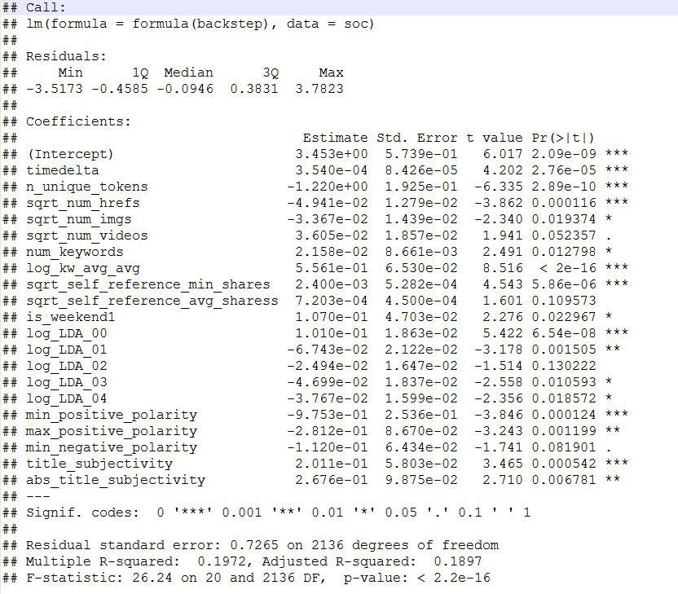
PCA(Backward Selection)
Presented by Abhinav Singh

Slide 20
CLASSIFIER MEASURES (ACCURACY & KAPPA MEASURES)
Presented by Abhinav Singh
Classifiers | Accuracy | Kappa
Random Forests | 67.12% | 32.24%
eXtreme Gradient Boosting | 67.04% | 21.19%
SVM(Radial) | 65.99% | 31.32%
Generalized Linear Model | 65.40% | 30.26%
Logistic Regression | 62.78% | 39.51%
CART (Classification and Regression Trees)(Trials = 5) | 61.92% | 23.98%
Neural Networks (15 hidden Units) | 61.76% | 38.55%
Boosted Logistic Regression | 60.84% | 30.22%

Slide 21
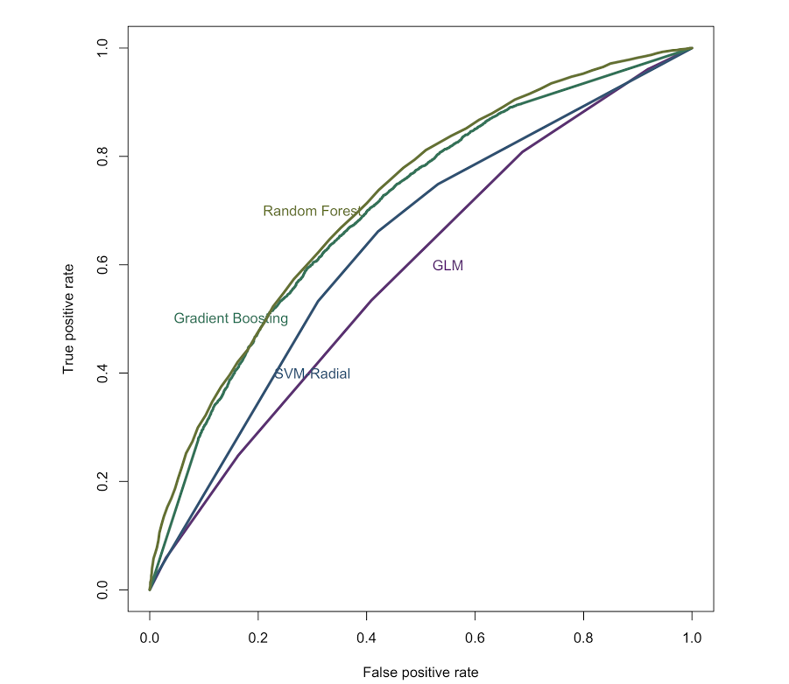
ROC
Presented by Abhinav Singh

Slide 22
QUESTIONS…

